Slide 1
Variants of known functional consequence
Sequence and structural features
Distance matrix
Variant-level phenotypes
RBF kernel
Clustering
HPO kernel
Instance-level structural similarity
Hierarchy and task-wise similarity
Instance-level phenotypic similarity
Multi-task multi-kernel learning (MTMKL)
C-SVM
Prediction: GOF/LOF

Slide 2
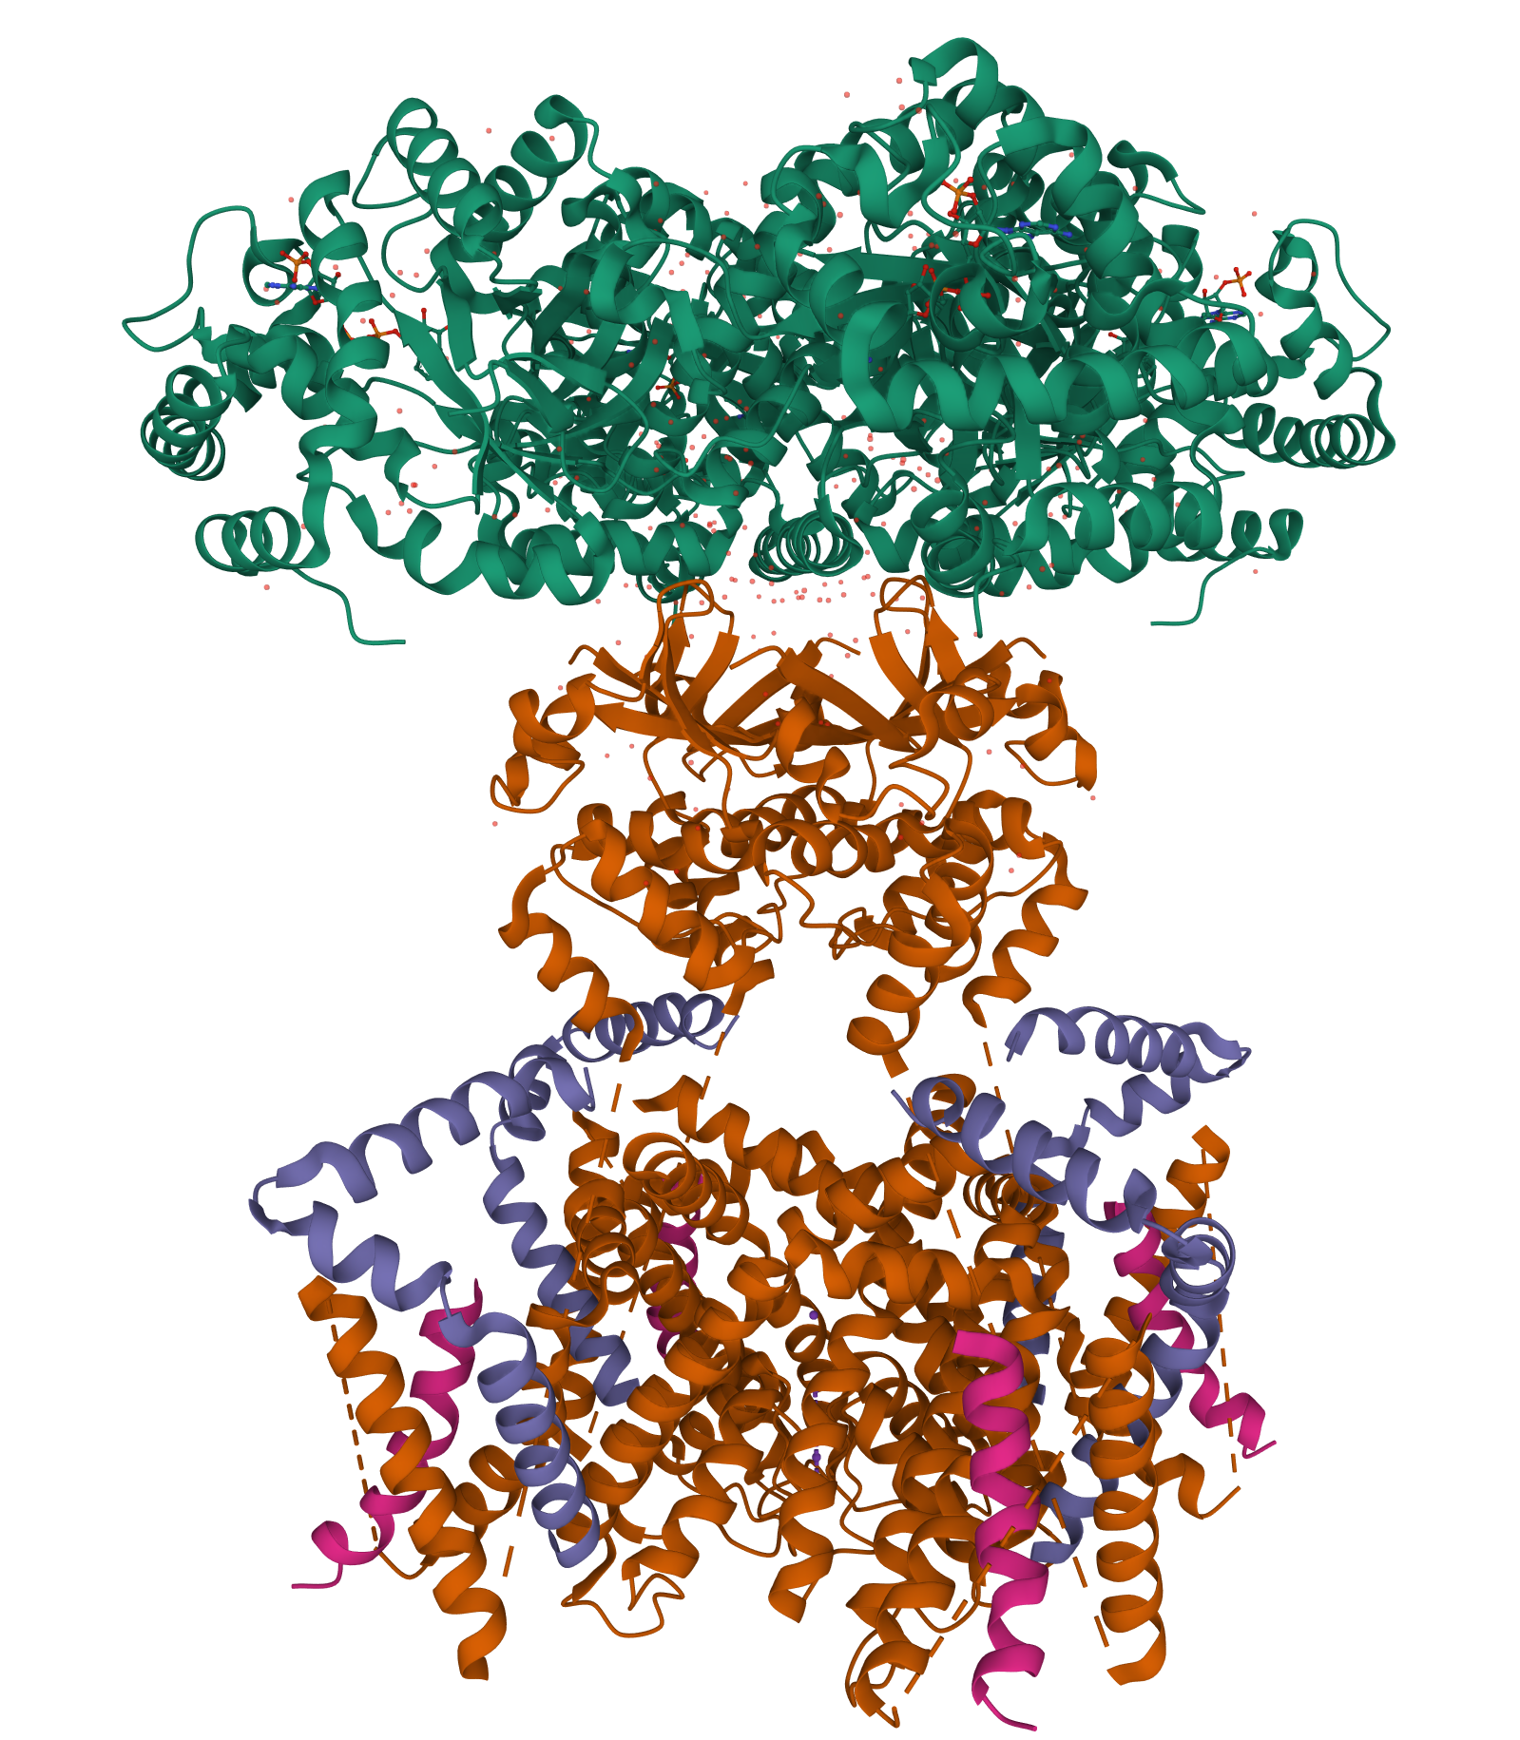
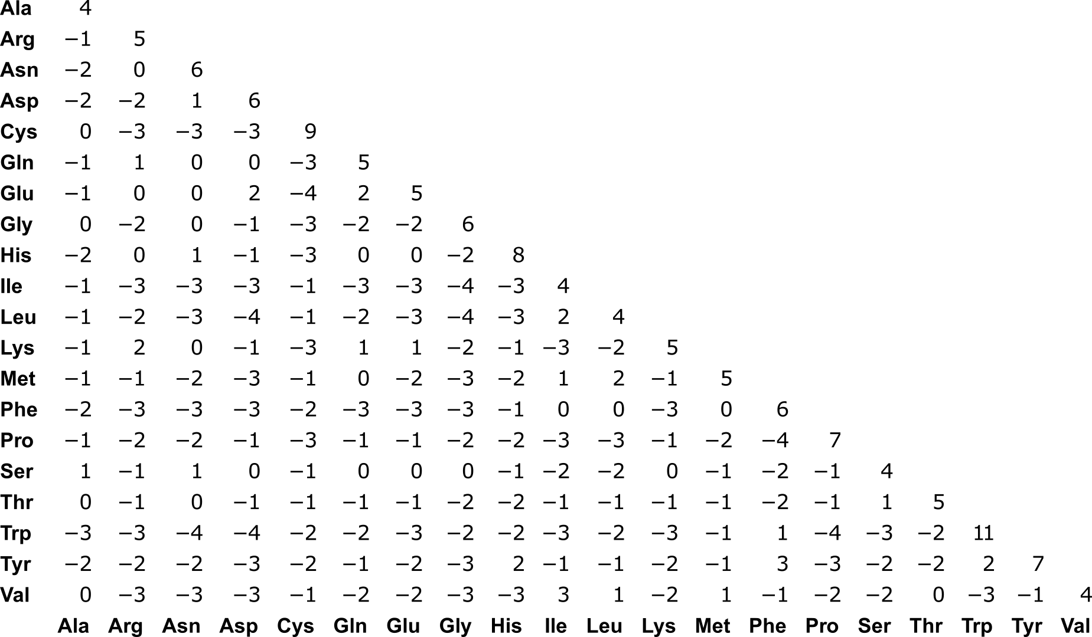
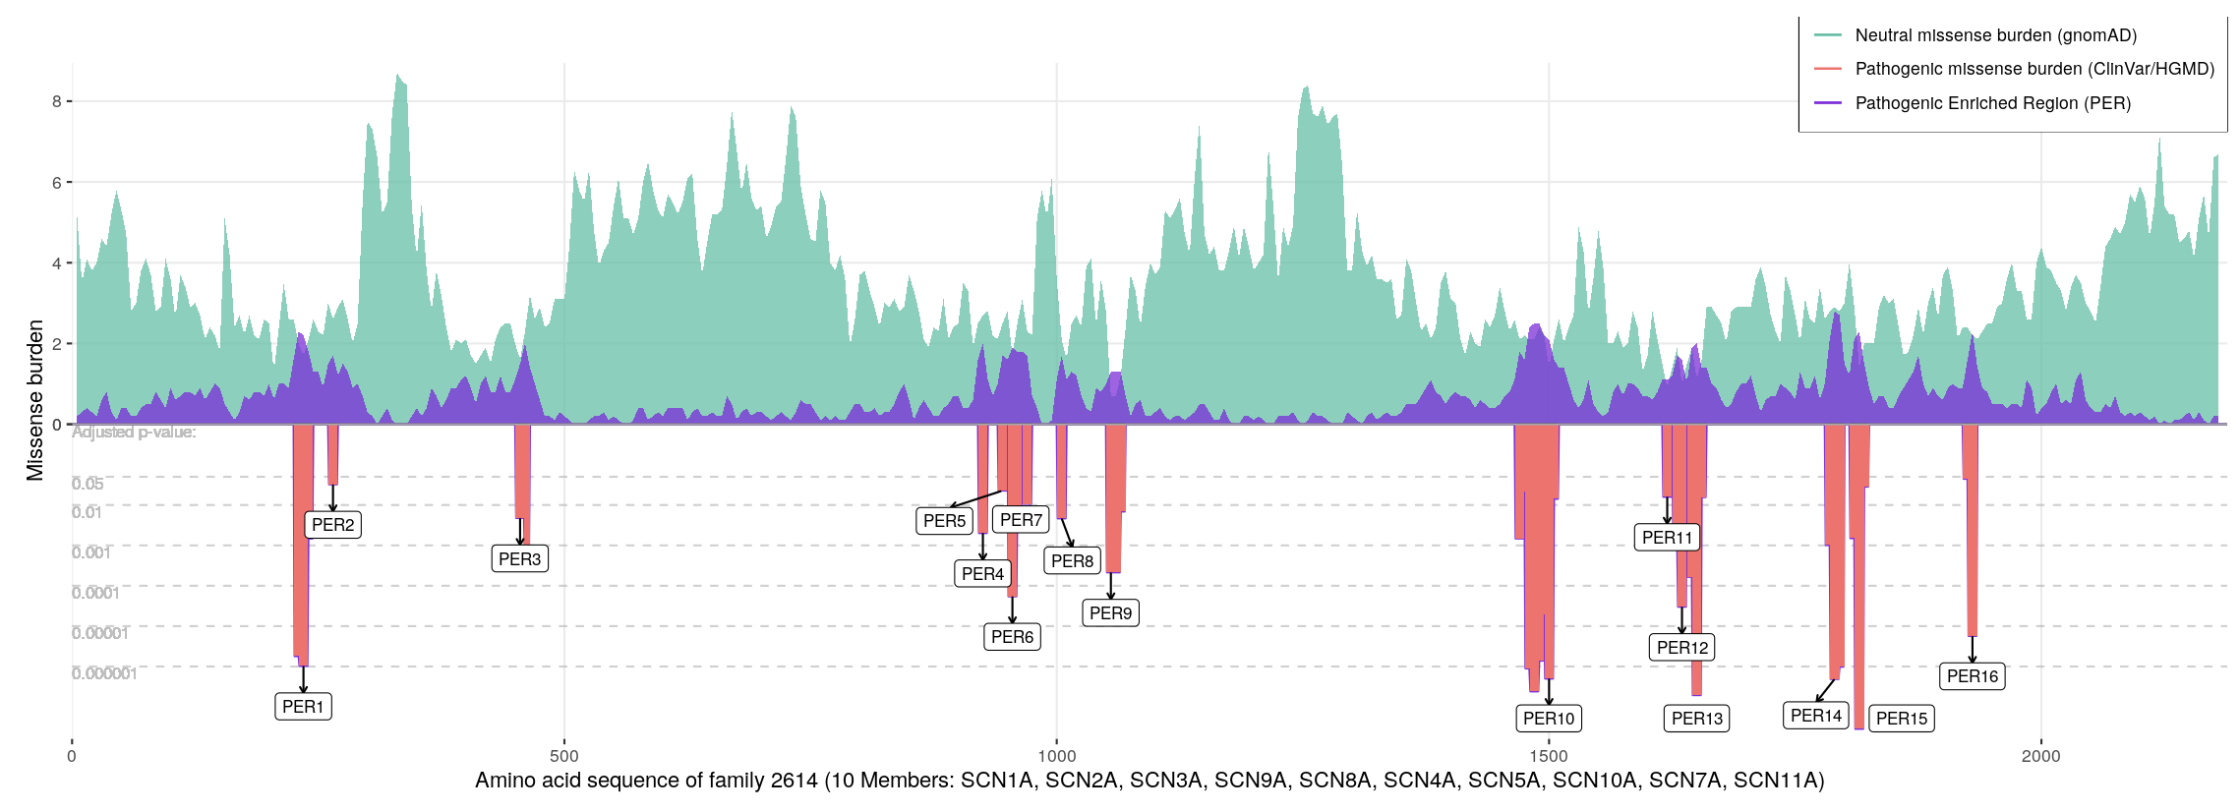
Variants of known functional consequence
Amino acid physicochemical properties
Radicality of exchange
Accessible surface area
Local disorder
Secondary structure
Protein-protein binding sites
Functional domains and motifs
Relative sequence position
Sequence position on family alignment
Transmembrane topology
Paralog and ortholog conservation
Sequence and structural features
RBF kernel
Instance-level structural similarity

Slide 3
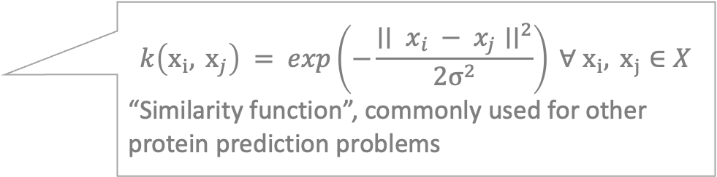
Variants of known functional consequence
Sequence and structural features
$$k\left(x_{i}, x_{j}\right) = exp\left(−\frac{∣∣ x_{i} − x_{j}∣∣^{2}}{2σ^{2}}\right) ∀ x_{i}, x_{j}∈X$$
“Similarity function”, commonly used for other protein prediction problems
RBF kernel
Instance-level structural similarity

Slide 4
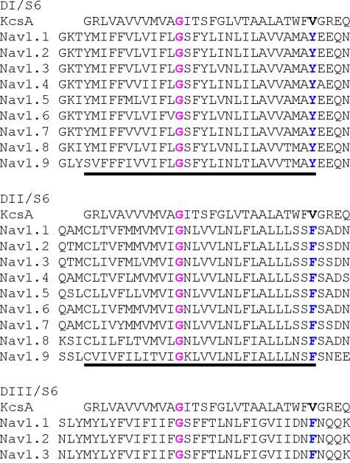
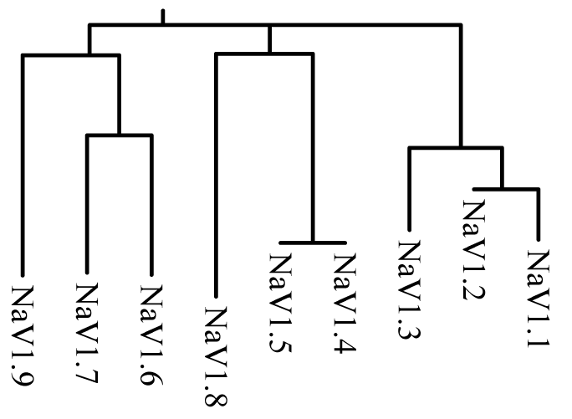
Variants of known functional consequence
Sequence and structural features
Distance matrix
Clustering
Standard multiple-sequence alignment (MUSCLE)
Potential refinement of task-wise similarity with RMTL
Hierarchy and task-wise similarity

Slide 5
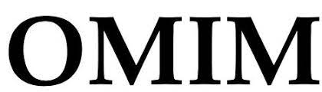

Variants of known functional consequence
Human phenotype ontology (HPO) mapping from OMIM terms or raw clinical data
Variant-level phenotypes
HPO kernel
Instance-level phenotypic similarity

Slide 6
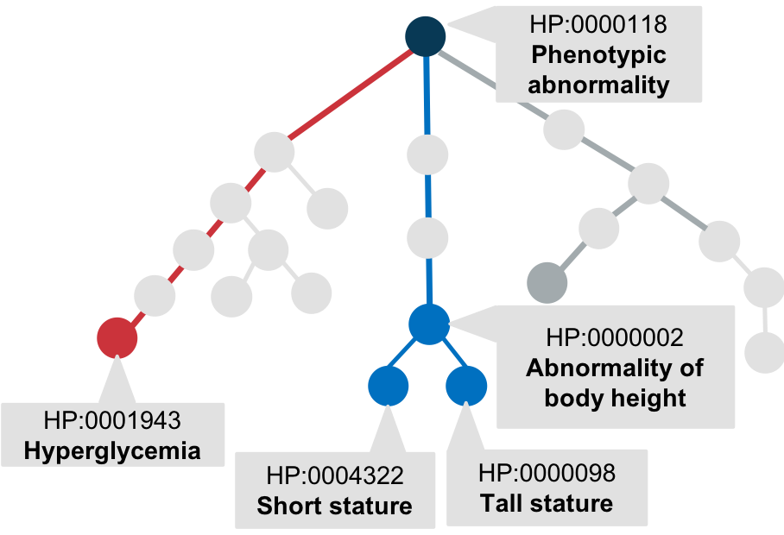
Variants of known functional consequence
Propagate terms along ontology.
Optional permutation testing for sparse and noisy phenotypes.
For each method (Jaccard, Lin, Resnik) obtain pairwise semantic similarity values.
Jaccard results in a psd matrix.
For Lin and Resnik, approx. nearest psd matrix.
Include choice of semantic similarity method in cross-validation.
Variant-level phenotypes
Novel implementation of ‘kernelized’ phenotypic semantic similarity analysis
HPO kernel
Instance-level phenotypic similarity

Slide 7
Variants of known functional consequence
Sequence and structural features
Distance matrix
Variant-level phenotypes
RBF kernel
Clustering
HPO kernel
Instance-level structural similarity
Hierarchy and task-wise similarity
Instance-level phenotypic similarity
Multi-task multi-kernel learning (MTMKL)
C-SVM

Slide 8
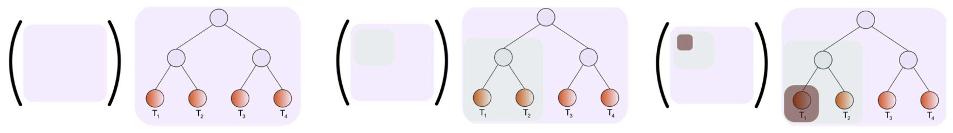
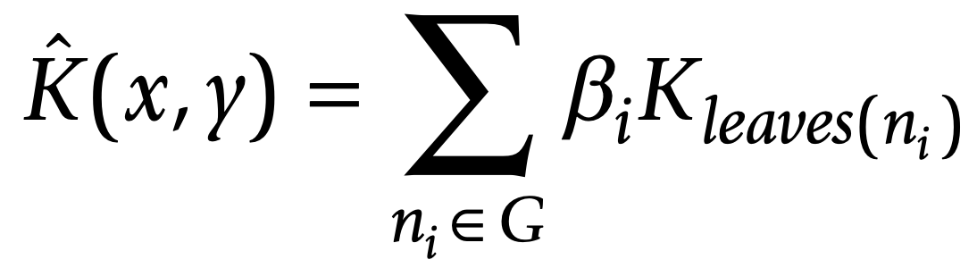
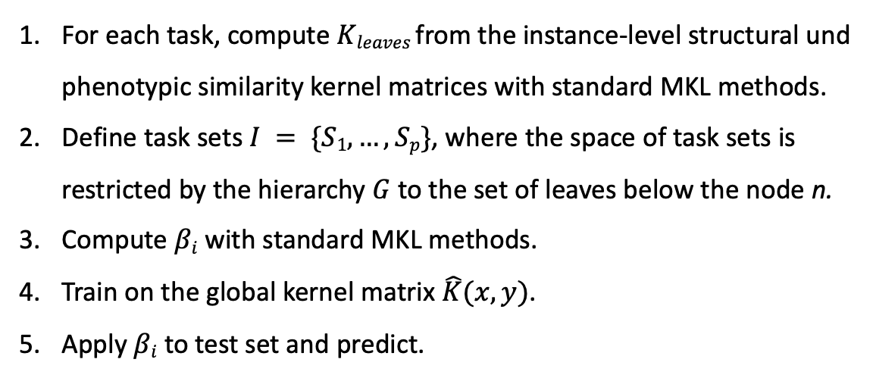
Hierarchical decomposition multi-task multiple kernel learning (MTMKL)
For each task, compute $Kleaves$from the instance-level structural und phenotypic similarity kernel matrices with standard MKL methods.
Define task sets $I = \{S1,…,Sp\}$, where the space of task sets is restricted by the hierarchy $G$ to the set of leaves below the node n.
Compute $βi$ with standard MKL methods.
Train on the global kernel matrix $\hat{K}(x,y)$.
Apply $βi$ to test set and predict.
Widmer, C., et al. Inferring latent task structure for Multitask Learning by Multiple Kernel Learning. BMC Bioinformatics 11, S5 (2010).

Slide 9
Variants of known functional consequence
Sequence and structural features
Distance matrix
Variant-level phenotypes
RBF kernel
Clustering
HPO kernel
Instance-level structural similarity
Hierarchy and task-wise similarity
Instance-level phenotypic similarity
Multi-task multi-kernel learning (MTMKL)
C-SVM
Prediction: GOF/LOF

Slide 10
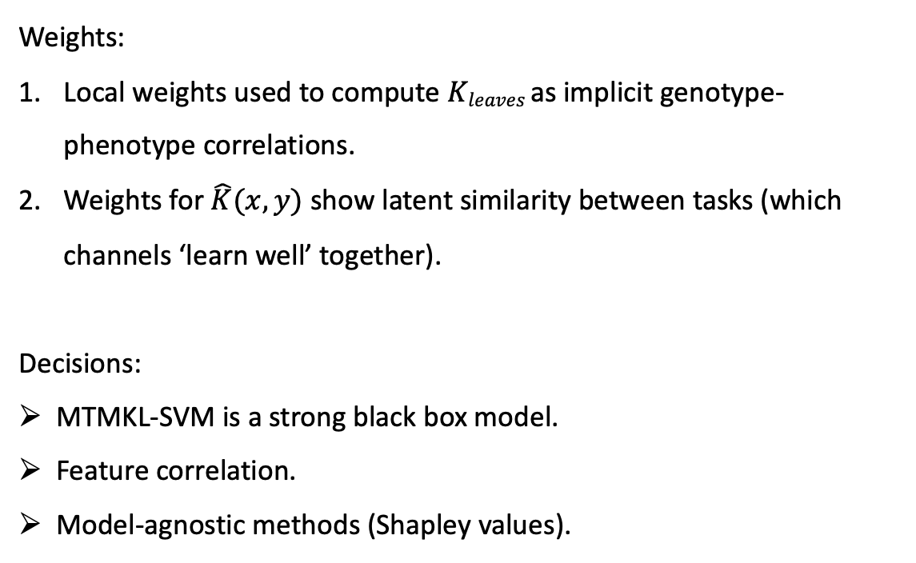
Interpretability
Weights:
Local weights used to compute $Kleaves$as implicit genotype-phenotype correlations.
Weights for $\hat{K}(x,y)$ show latent similarity between tasks (which channels ‘learn well’ together).
Decisions:
MTMKL-SVM is a strong black box model.
Feature correlation.
Model-agnostic methods (Shapley values).

